Slide 1
Android Development
Android Studio, Activities & Fragments

Slide 2
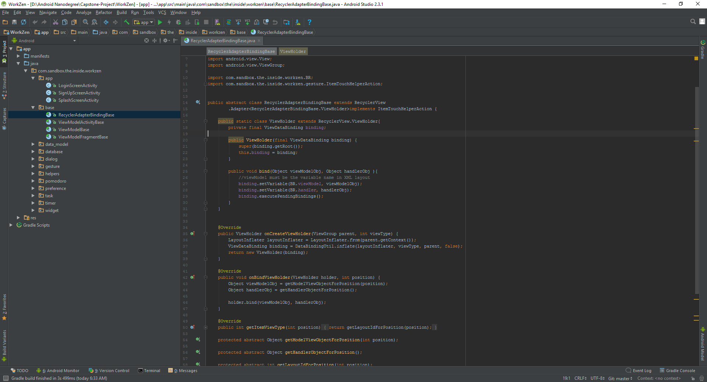
Android Studio
De facto standard for Android development
Built on the IntelliJ
Some features
Layout Editor
Built in emulator
Gradle integration
Instant Run (Hot swap)
https://developer.android.com/studio/index.html

Slide 3
Activity
Fundamental building blocks
Entry point for a user's interaction
Navigates within an app

Slide 4
Creating an Activity

